Slide 1
Descriptive Analysis: Personal Medical Costs
Author: Jamie Parra
CEN 4930 – Exploratory data analysis

Slide 2
Dataset
Variable Name | Data Type | Field Size | Description | Example
Age | int | 3 | Client age | 20
Gender | String | 10 | Client Gender | Male
BMI | int | 3 | Client BMI | 25
Children | int | 2 | Children cared for | 3
Smoker | string | 10 | Smoking cigarettes | yes
Region | string | 20 | USA region | Southeast
Charges | int | 10 | Medical bill amount | 13000
Hospital | String | 30 | Hospital name | Boston Memorial
This dataset consists of Data from a sample of data of patient information regarding their lifestyle and basic information. It does not including information such as name or address for Hipa purposes.
https://www.kaggle.com/datasets/mirichoi0218/insurance/data

Slide 3
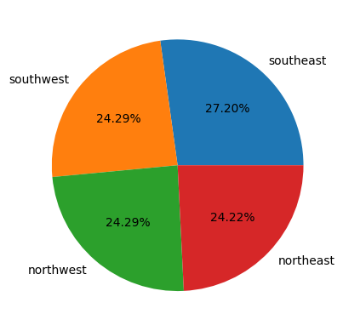
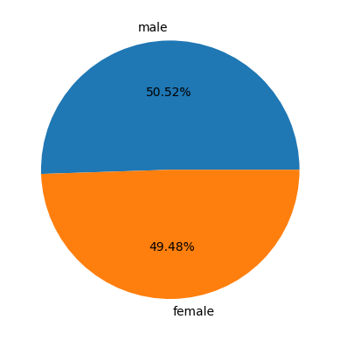
Dataset

Slide 4

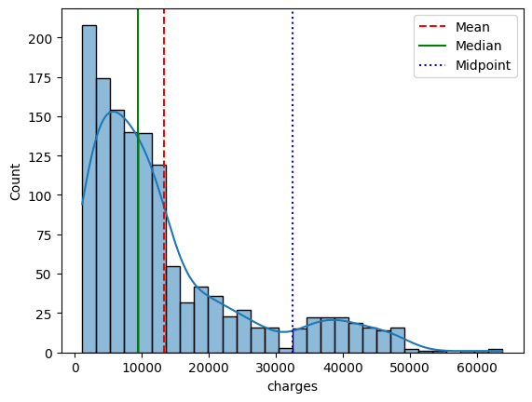



Total Chages Dispersion Measures

Slide 5
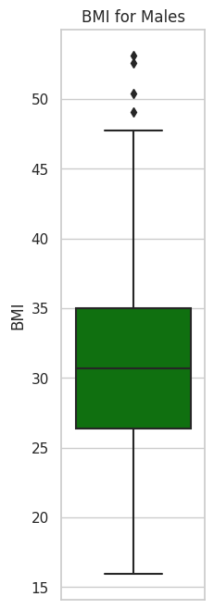
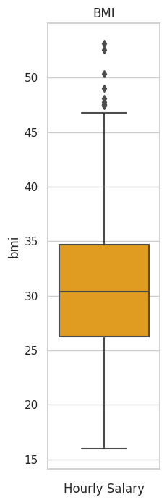
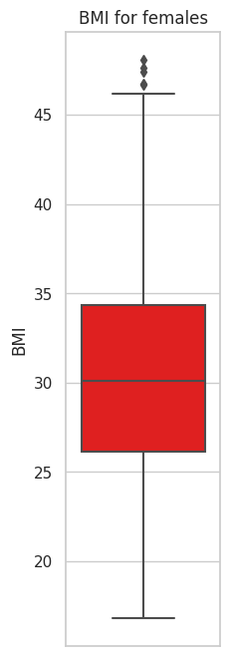
BMI

Slide 6
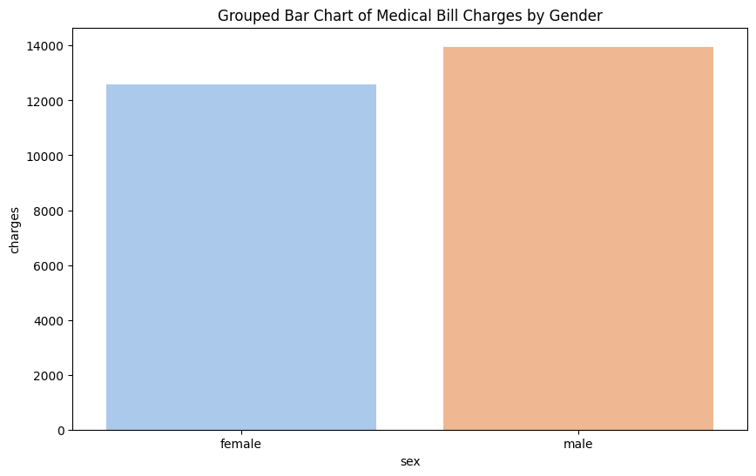
Men vs Women

Slide 7
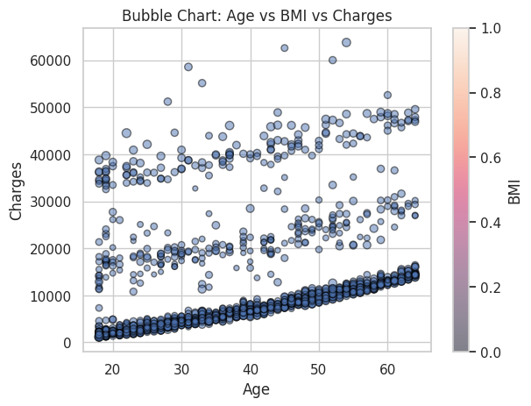
Age vs BMI vs Charges

Slide 8
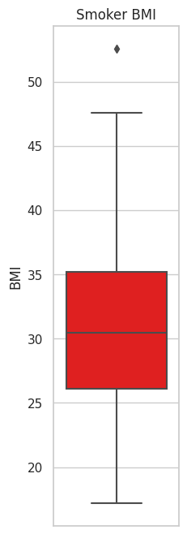
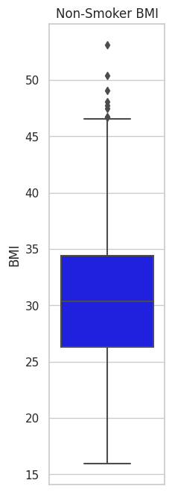
Smoker

Slide 9
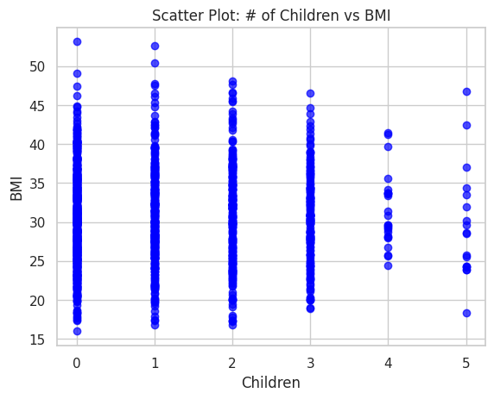
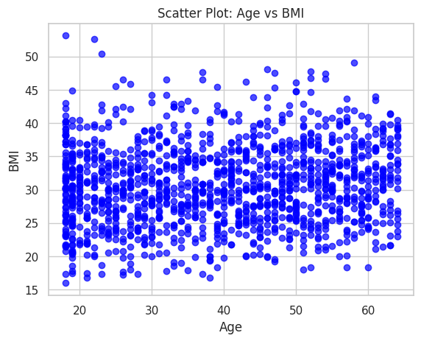
BMI Correlations

Slide 10
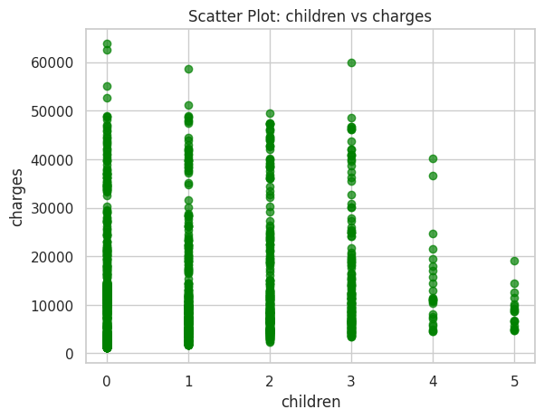
Children

Slide 11
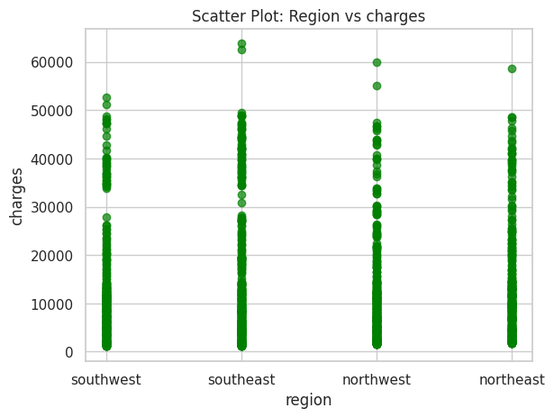
Regions

Slide 12
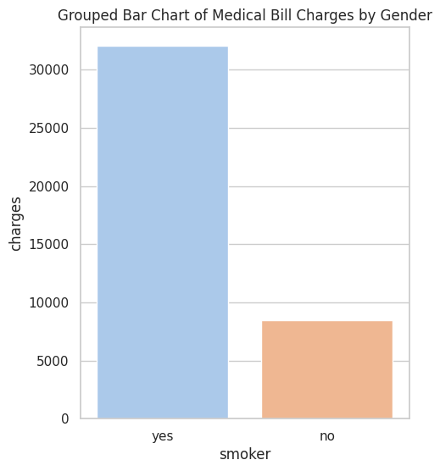
Smoking result on Charges

Slide 13
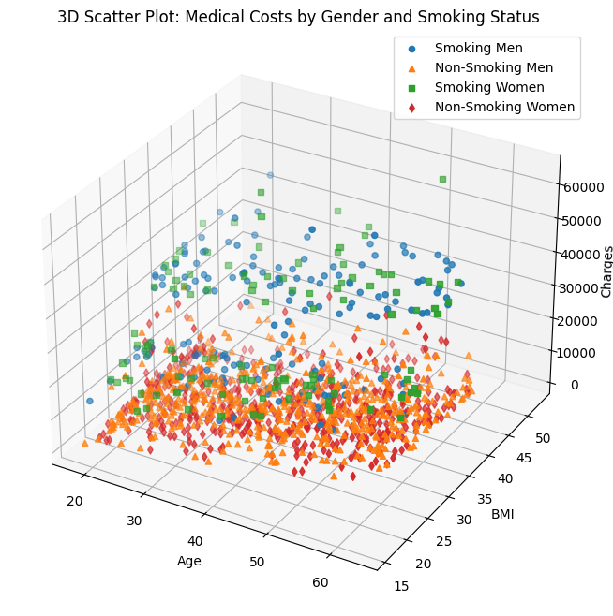
3D Scatter Plot: Medical Costs by Gender and Smoking Status

Slide 14
Conclusion
Having a higher BMI, Age, and smoke results in the highest insurance premium out of any other category.
Having children does not increase your risk of health problems.
Having a higher BMI drastically increases your risk of having higher medical bills.
Smoking severely affects health and results in much higher medical bills.
Age does not have a direct correlation on BMI. BMI is more correlated to lifestyle that people maintain as shown in the 3 categories in the bubble chart.
Clients higher in age tend to have slightly higher medical costs than younger people of similar BMI.
Young people have a high chance of having high medical costs.
Including exercise level could help create better results.

